Slide 1
Case study: System optimization of FPGA-accelerated FIR application
Junning Fan
UNSW Sydney

Slide 2
Interface protocols in HLS
The IO ports are defined with INTERFACE pragma:
applied on each argument of the synthesised function
Special case: port =return for the return value, as well as control signals
E.g. #pragma INTERFACE s_axilite port=a
Generates data ports or AXI-compliant IO ports:
ap_none/ap_vld: data port
s_axi/s_axilite: AXI memory mapped ports
axis: AXI-stream streaming port
Offer different IO throughput, latency and resource overhead.

Slide 3
Burst/Streaming vs AXI-Lite
AXI-Lite takes at least 3 clock cycles to transmit a word:
1st Clock: Master send read request, read address
2nd Clock: Slave presents data lines, assert read data valid
3rd Clock: Master acknowledges the read by asserting data ready
In bursting AXI-4 or streaming AXI-Stream:
Burst: Multiple words can be transmitted with only 1 addressing cycle
Streaming: No memory addressing
Much higher throughput

Slide 4
Function-wide pipelining
PIPELINE pragma can be applied to a function body:
Pipeline all the operations in a function body
Same syntax as pipelining loops
Pipelining a function unrolls all loops in the function

Slide 5
HLS code for FIR
#define TAP_DEPTH 128
void fir(float* input, float* output, float weights[TAP_DEPTH]) {
static float shift_reg[TAP_DEPTH] = {};
float acc = 0;
TDL:for(int i = TAP_DEPTH-1; i >= 1; --i) {
shift_reg[i] = shift_reg[i-1];
}
shift_reg[0] = *input;
MAC:for(int i = 0; i < TAP_DEPTH; ++i) {
acc += shift_reg[i] * weights[i];
}
*output = acc;
}

Slide 6
Default HLS implementation with AXI-Lite interface

Slide 7
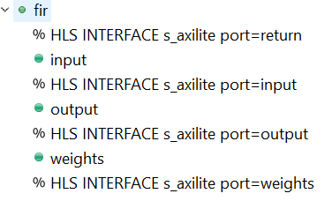
HLS pragma for baseline FIR
Implement the input port as AXI-Lite (low performance without bursting)
Implement the output port as AXI-Lite (low performance without bursting)
Implement the interface of weights memory as AXI-Lite (low performance without bursting)

Slide 8
Pipelined HLS implementation with AXI-Lite interface

Slide 9
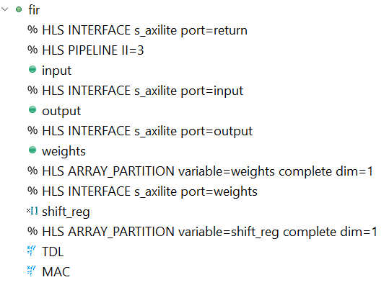
HLS pragma for pipelined FIR w/o bursting IO
Pipelines the function with initialize interval of 3
Partition the array to support simultaneous read/write in the unrolled loops

Slide 10
Pipelined HLS implementation with AXI-Stream interface

Slide 11
HLS code for streaming,pipelining FIR
typedef struct {
fir_type_t val;
ap_uint<1> last;} io_type_t;
void firOptimized(hls::stream<fir_type_t>& input, hls::stream<io_type_t>& output_stream, fir_type_t weights[TAP_DEPTH]) {
static fir_type_t shift_reg[TAP_DEPTH];
fir_type_t acc = 0;
shift_loop: for(int i = TAP_DEPTH-1; i >= 1; --i) {
shift_reg[i] = shift_reg[i-1];
}
shift_reg[0] = input.read();
mac_loop: for(int i = 0; i < TAP_DEPTH; ++i) {
acc += shift_reg[i] * weights[i];
}
io_type_t output;
output.val = acc;
static ap_uint<7> counter = 0;
if (counter++ == TAP_DEPTH-1) {
output.last = 1;
} else {
output.last = 0;
}
output_stream.write(output);
}
Special IO data for streaming in Vivado HLS
Control signal for streaming IO type

Slide 12
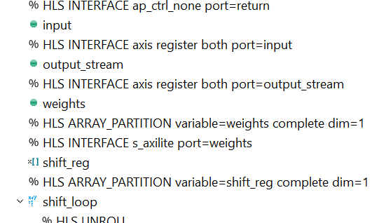
HLS pragma for pipelined FIR with streaming
AXI-stream interface

Slide 13
Resource Utilization
 | Baseline | Pipe w/o burst | Pipe with stream
LUT | 752 | 25321 | 28425
FF | 613 | 38809 | 41534
DSP | 5 | 215 | 215
Relative throughput | 0.337 | 5.48 | 22.9

Slide 14
Relative throughput

Slide 15
Takeaway messages 1
Programmable logic implementation does NOT guarantee speed-up
Pipelined/unrolled implementation can result in very large circuit

Slide 16
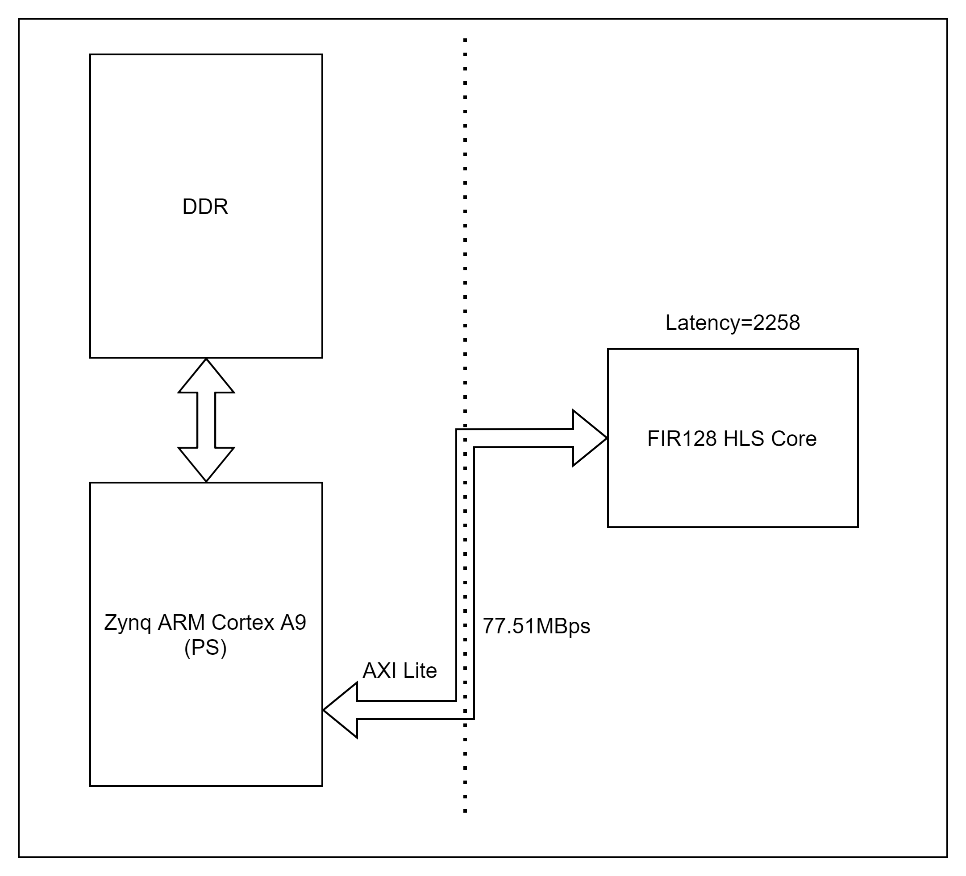
Bottleneck of each design
Types of bottleneck?
Compute-bound or IO bound?
Identify bottlenecks of each design
Hint: compute the bandwidth needed for a design to run at full speed
Assume:
Frequency of 160MHz

Slide 17
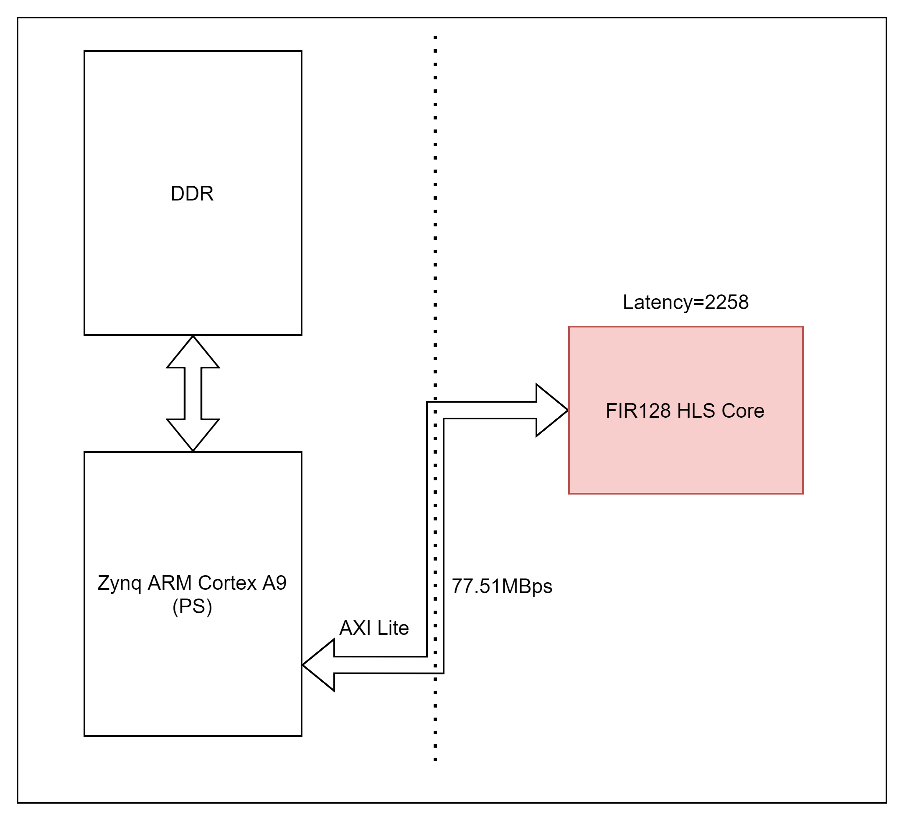
Baseline HLS
Bandwidth needed: $\frac{4}{2256}∗160∗{10}^{6}=\text{283.687 }\text{KBps}$
Compute-bound

Slide 18
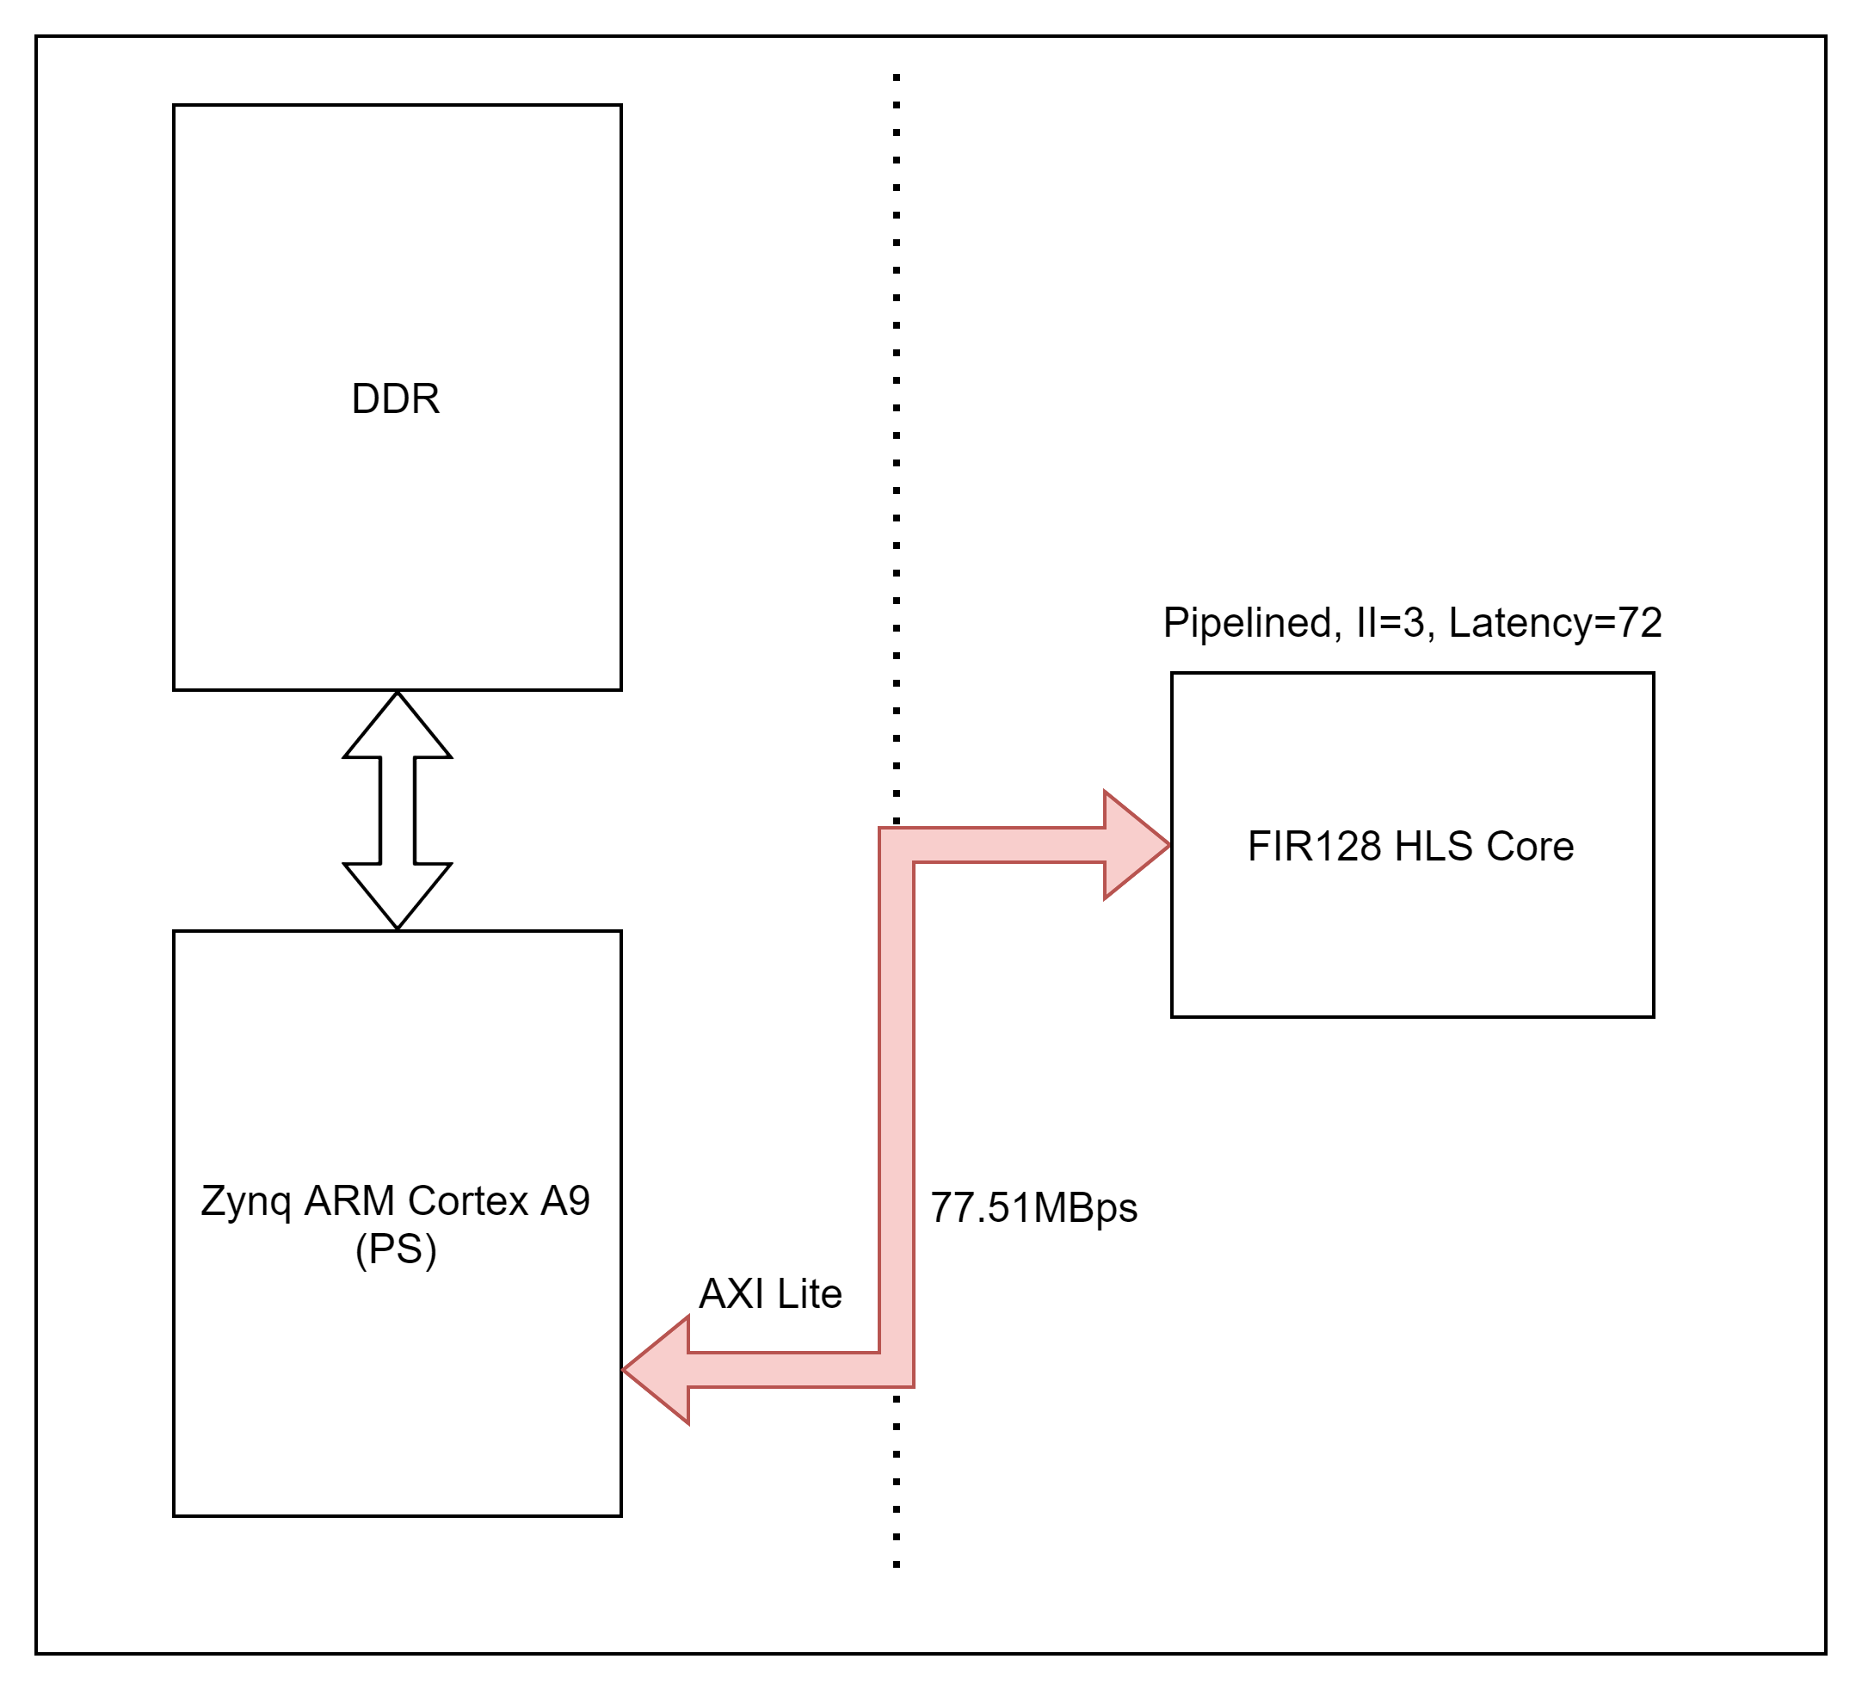
Pipelined HLS with AXI-Lite
Bandwidth needed: $\frac{4}{3}∗160∗{10}^{6}=213.3MBps$
IO-bound

Slide 19
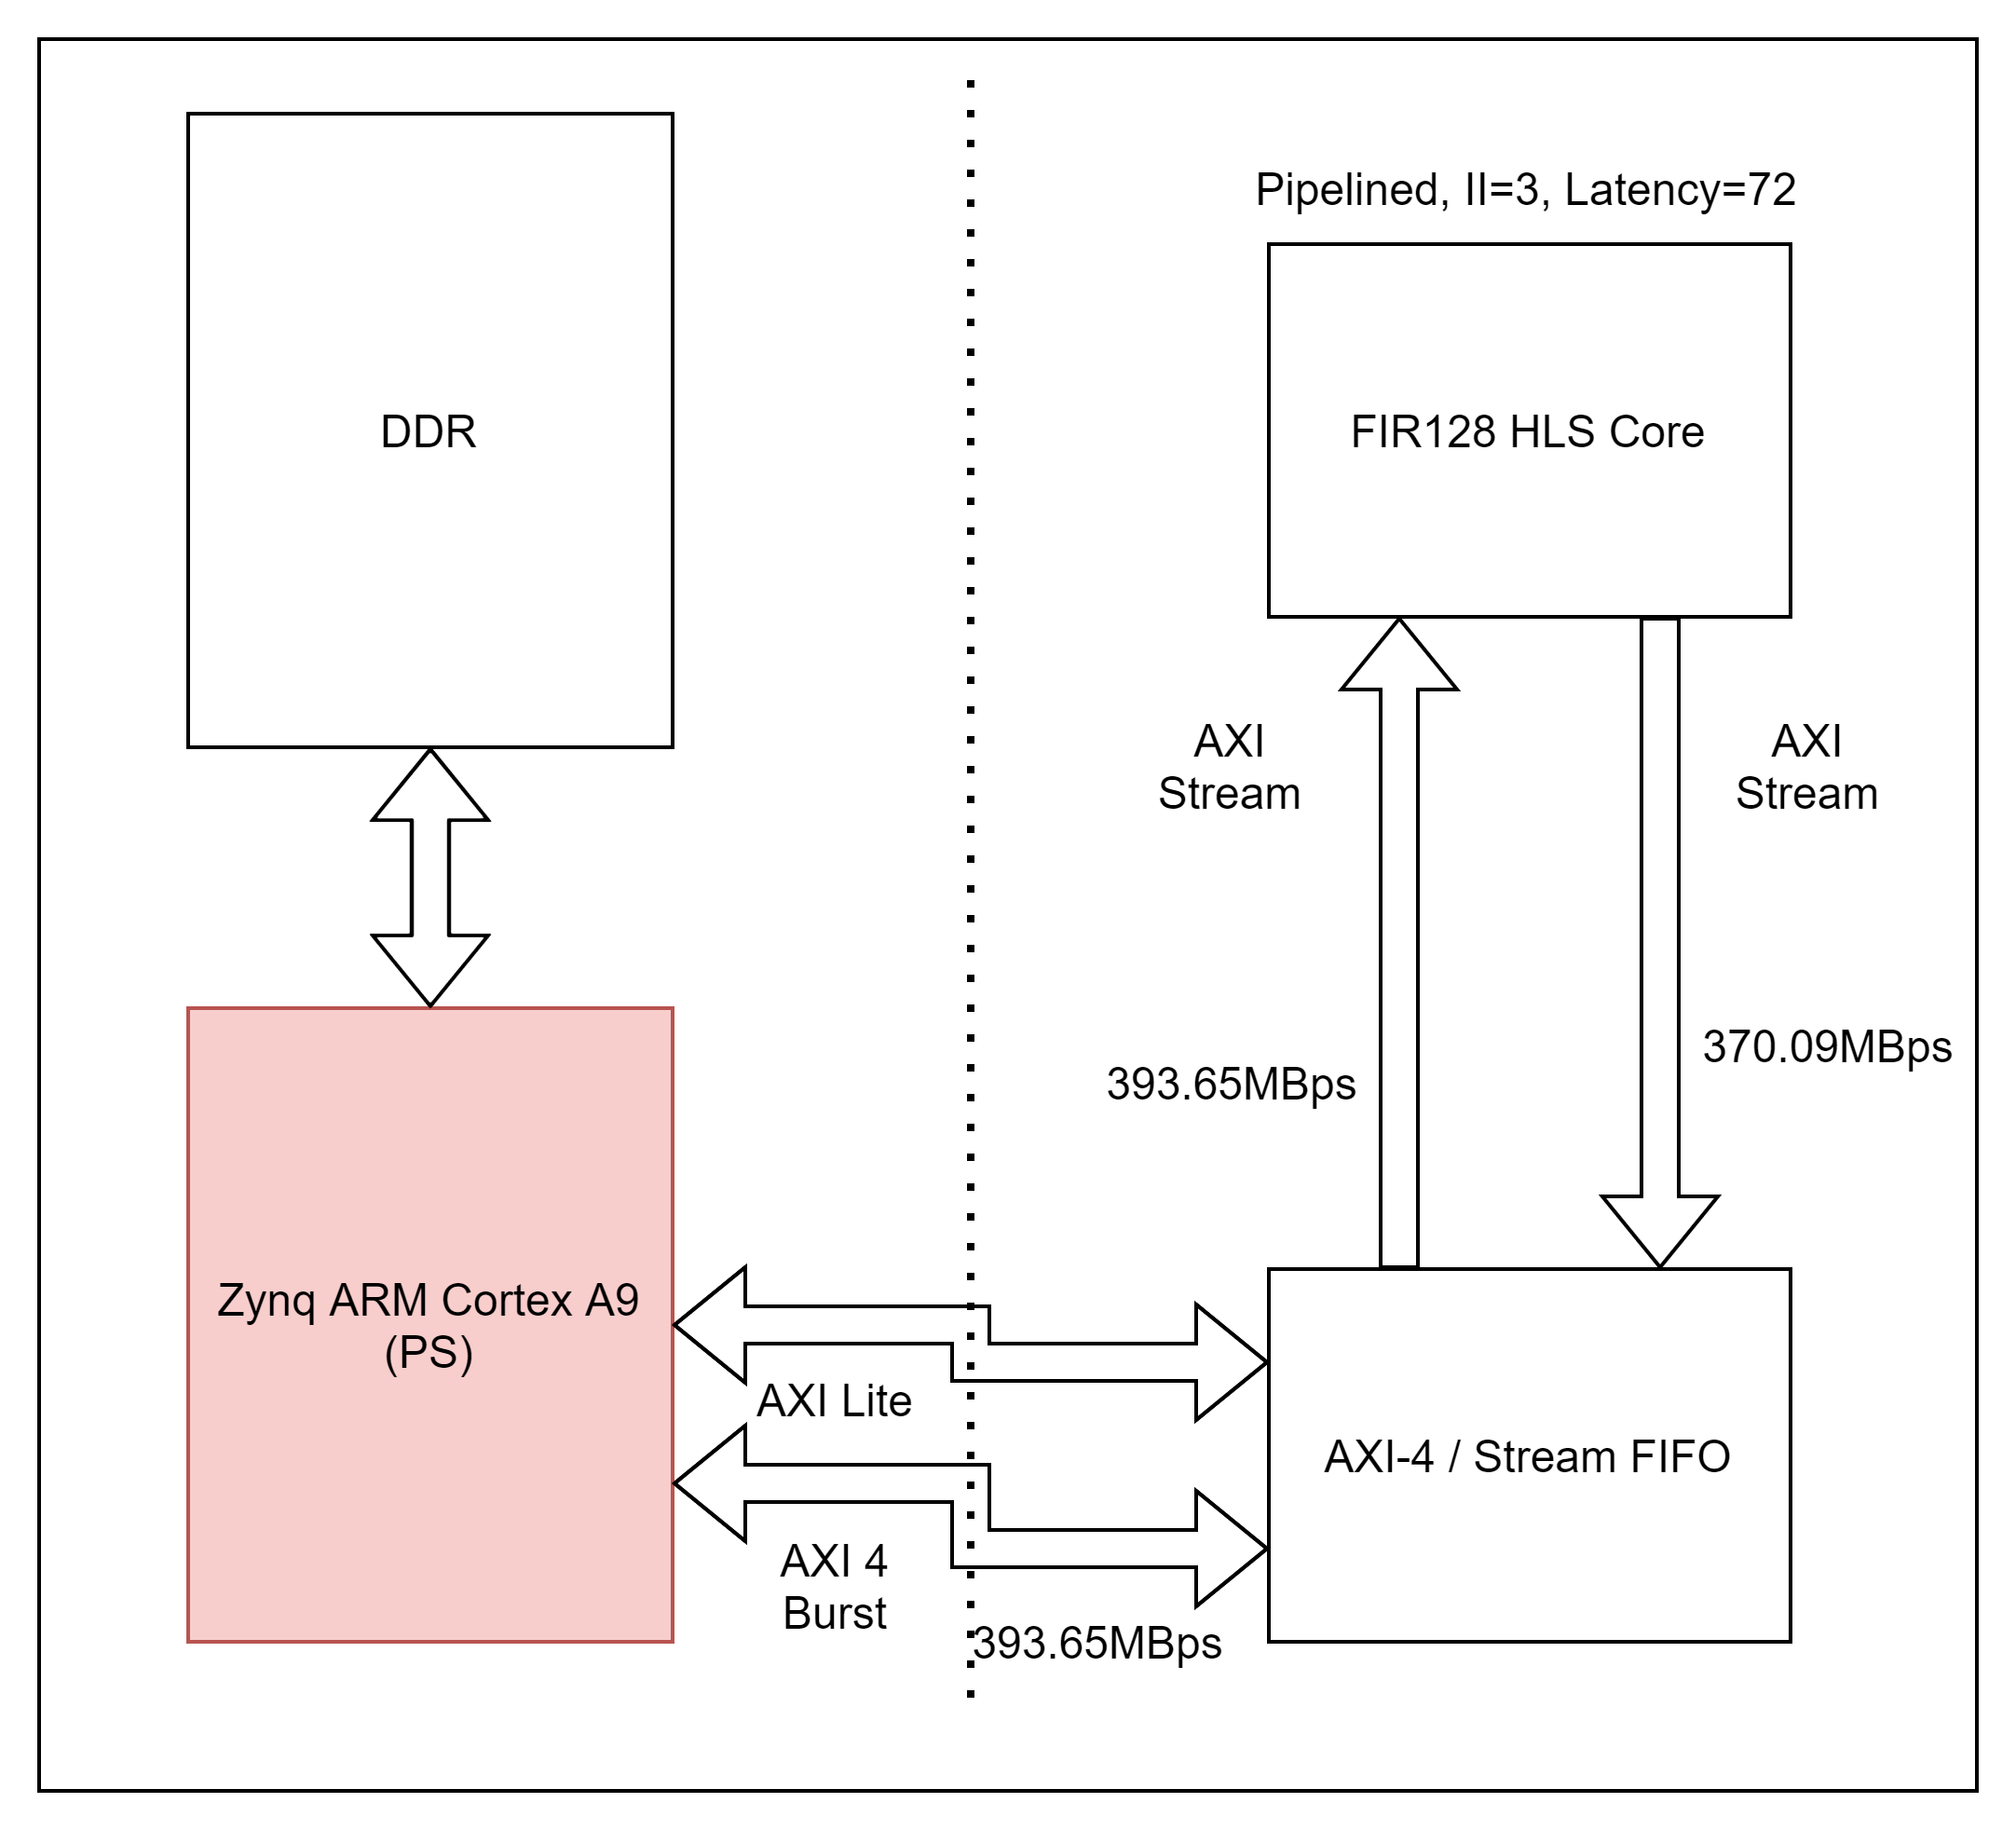
Pipelined HLS with AXI-Stream
Bandwidth needed: $\frac{4}{3}∗160∗{10}^{6}=213.3MBps$
Sub-optimal software implementation

Slide 21
Takeaway messages 2
The IO interface should be chosen carefully to meet the bandwidth requirement of HLS designs
PS system (software and DDR) should be able to feed data fast enough to PL system

Slide 22
Thank you!

